Slide 1
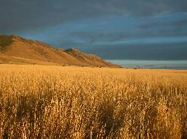
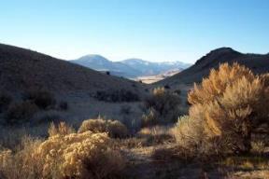



Linking Local Monitoring to the Big Picture: an Example from Important Bird Areas
Tania Homayoun
Conservation Biology Graduate Program
University of Minnesota
December 8, 2009

Slide 2
Overview
Background
  Landbird monitoring in the Mississippi River Twin Cities Important Bird Area
Web-based data entry system and database: www.ibamonitoring.org
Connecting local bird monitoring to the bigger picture

Slide 3
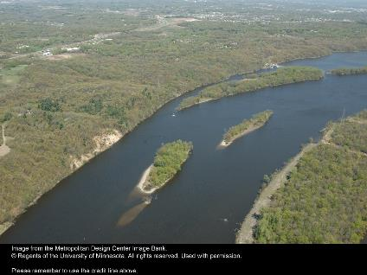
Important Bird Areas
Important Bird Areas (IBA) Program
  Identify valuable bird habitat
  Work to protect these areas
Monitoring
Assessment
Conservation Plan & Management
Mississippi River Twin Cities IBA habitat
Notes:
Important Bird Areas program is global initiative that identifies and advocates for protection of habitat areas that are of conservation value to one or more species of birds at some stage in their life cycle (breeding, migration, and/or over-wintering).
Image: MRTC IBA and bird habitat along the river that has escaped development

Slide 4
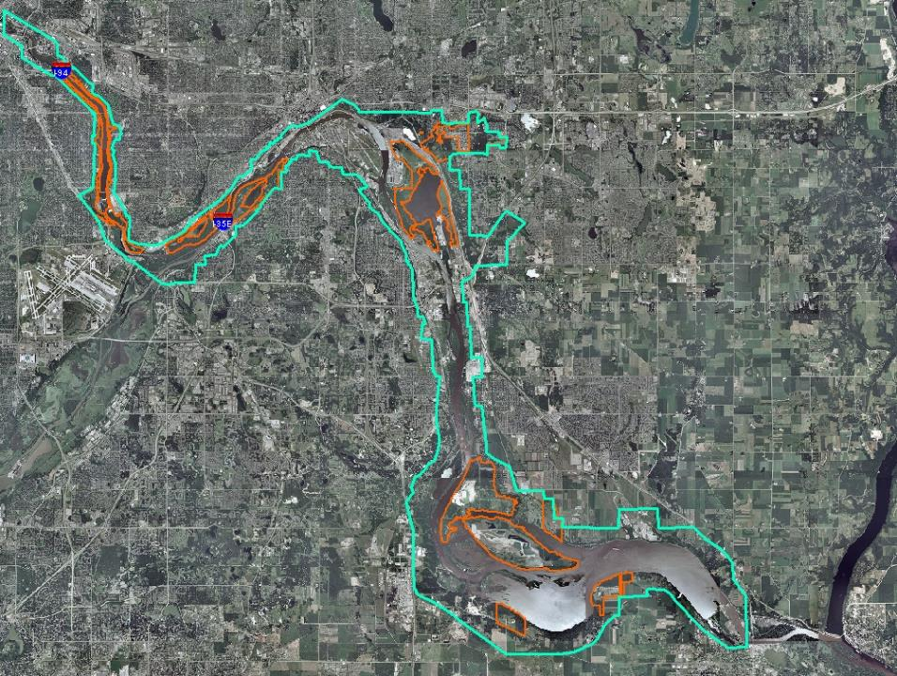
Saint Paul
Minneapolis
Notes:
From downtown Minneapolis to Hastings, MN
-14,751 hectares
-Roughly follows boundaries of the Miss. Nat’l River & Recreation Area (MNRRA)
-Regionally, lies at the confluence of the Miss. R., Minn. R., and St. Croix R., important migration area; on the Miss. River FlywayAreas in orange are parks, reserves, and open space.
Multiple layers of oversight: (city, county, state, and federal)
-Minneapolis City Parks
-Ramsey County
-Dakota County
-MN DNR
*Turquoise border shows IBA, which is same as MNRRA (National Park Service)

Slide 5
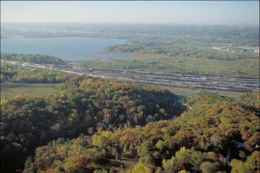
Monitoring the Twin Cities IBA
Citizen science program to monitor landbirds in the Mississippi River Twin Cities Important Bird Area
Stakeholder objectives:
Inventory landbird species
Seasonal patterns of habitat use (migration, breeding, winter)
Estimate relative abundances over time, long-term trends
Volunteer data collection with sustainable, standardized methodology
© Regents of the Univ. of MN. Used with permission of Metropolitan Design Center.
Mississippi River Twin Cities IBA, east of downtown St. Paul
Notes:
-In 2007, I began working with Audubon MN to design a monitoring program that would fill in the blanks regarding landbird use of this habitat area.
-Audubon’s primary interests are gaining information on species presence/absence, relative abundances.
***Prior to this project, there was not even a comprehensive species list for landbirds in the IBA.***

Slide 6
Protocol: Bird Surveys
5 minute Point Count technique
  Primarily forest habitat
Single observer + recorder(s)
2 distance bands (0m - 50m and >50m)
  Compromise--some training required
Migration Surveys
  From April 15 to May 30
  Goal: 6 visits
Breeding Season Surveys
  June 1-July 1
  Goal: 2 visits min.
Notes:
-Most of the habitat on sites is forested, so used point count
-5 min count duration-- Reasonable for detection of birds while maximizing number of sampling points
-2 distance bands--compromise between variable radius point counts used in NWR protocol and research projects and unlimited radius used in many volunteer surveys (ex. Tucson Bird Count)

Slide 7
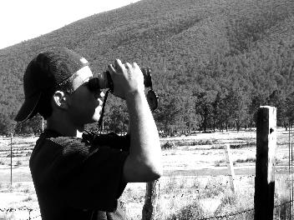
Pilot Season Evaluation: Future Needs
Online data entry
  Currently, volunteers submit paper datasheets for entry to spreadsheet
Data integration into larger-scale databases
Centralized project & volunteer coordination
Notes:
-Data should be made available to the National Park Service so MNRRA data can be integrated into the Great Lakes Monitoring Network database.

Slide 8
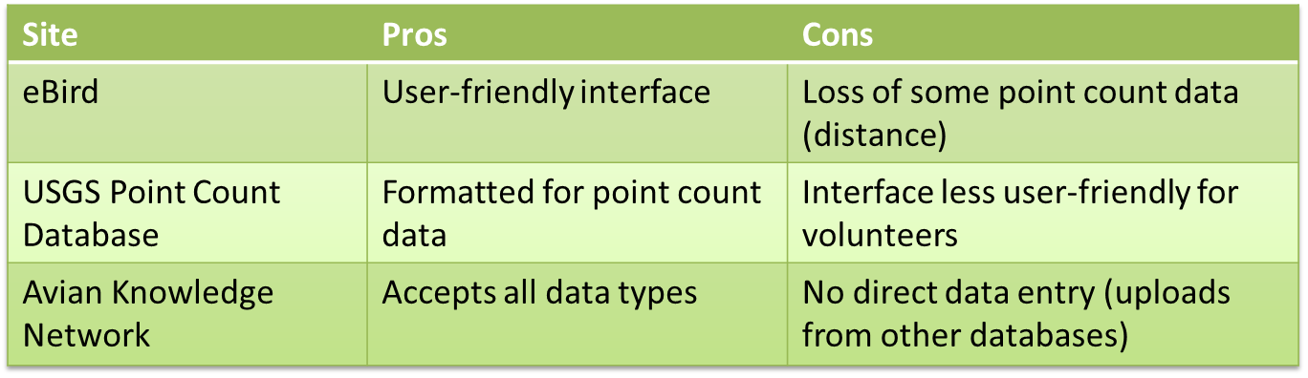
Evaluating Existing Infrastructure
Ideal
  Volunteer-friendly data entry interface
  Supports point count* data
  Share with multiple larger databases
  Manage volunteer information

Slide 9
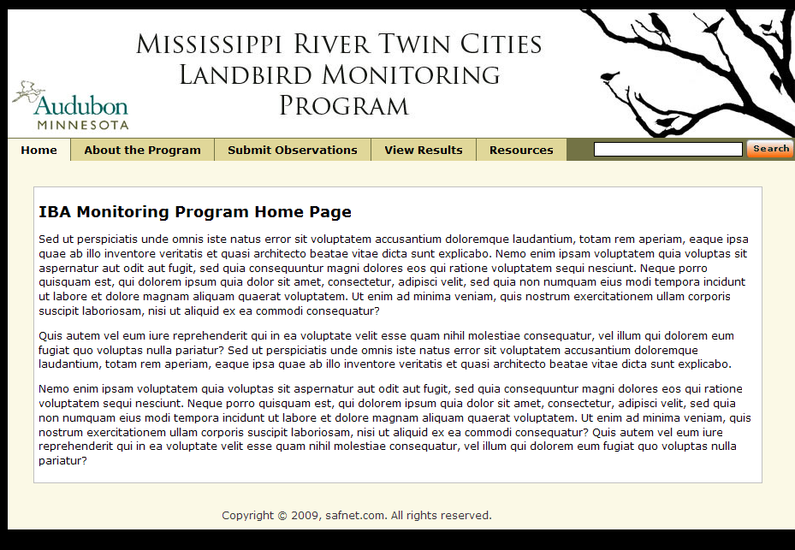
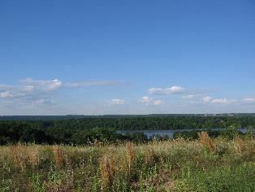
Welcome to the Mississippi River Twin Cities Important Bird Area Landbird Monitoring Program!
Thank you to all our volunteers who made the program’s third season a success. Since our first season in 2004, participants have counted 134 landbird species on 10 sites within the IBA during spring migration and summer breeding seasons.
Learn more about how this citizen science program is working to evaluate the state of landbird species in the Minneapolis-Saint Paul metro and how you can get involved.
Photo by T. Homayoun
Notes:
www.Ibamonitoring.org screenshot
Go into tour of the site’s functionalities

Slide 10
Twin Cities IBA Monitoring Website
Proposed functionalities
  Volunteer log-in
  Online data entry
  Program information & materials (protocols, maps, etc.)
  Online data reporting
  Ability to upload data to Avian Knowledge Network & other databases
  Database of volunteer & site information for Program Coordinator
Notes:
-List of functionalities
-Tour of data entry function

Slide 11
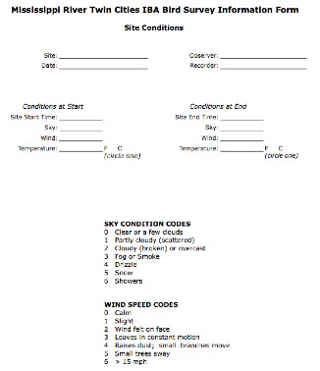
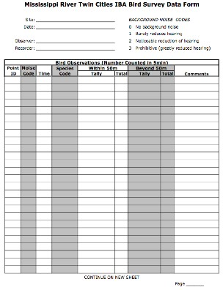

Slide 12
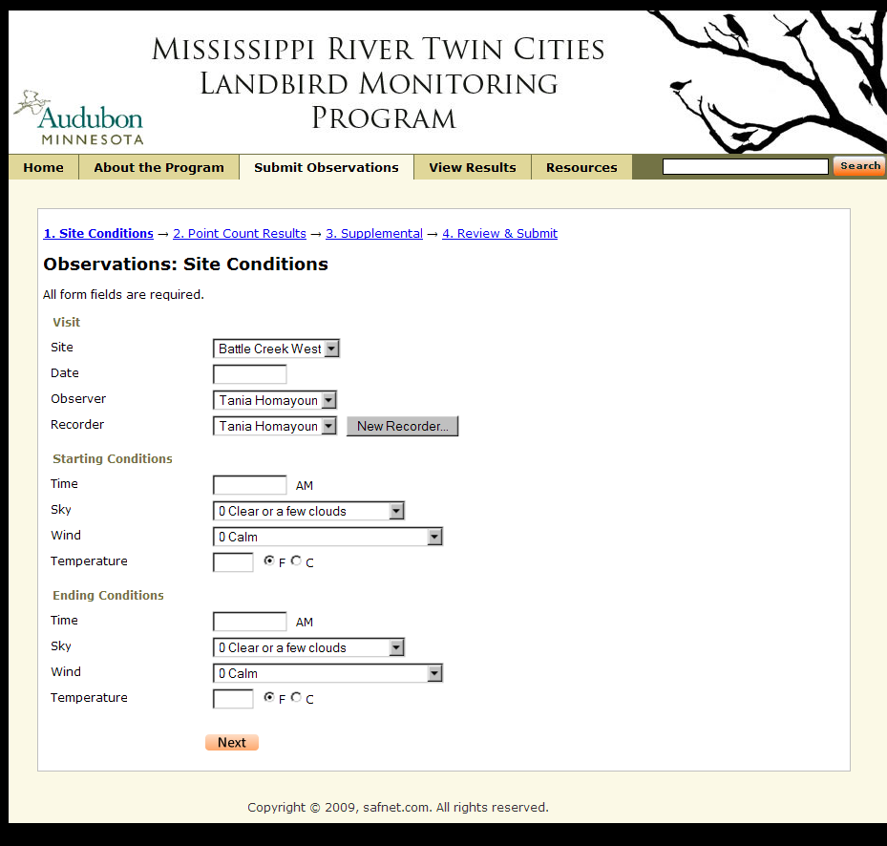
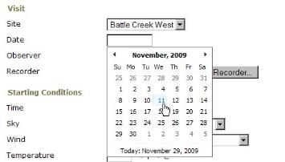
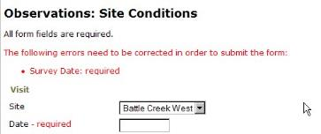
Notes:
First page under Submit Observations is Site Conditions
-mirrors the Site Conditions datasheet from field
-Examples of quality control checks we’ll be building into the data entry pages

Slide 13

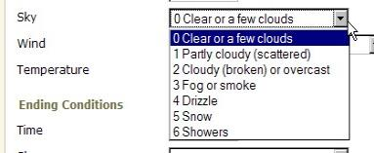
Notes:
For ease of use, we’ll be using drop-down menus where appropriate, again mirroring content on the data sheets.

Slide 14
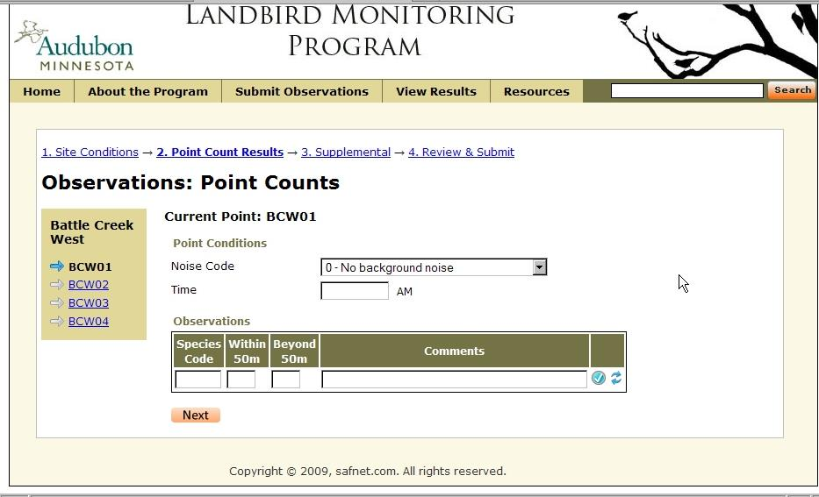
Drop-down menu
Advance to the next point
Notes:
This is the page where volunteers enter the point count data.
Noise codes (from datasheet) will be a drop-down menu.

Slide 15
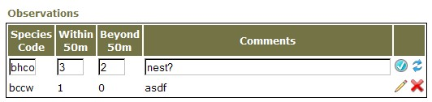
BGGN – Blue-gray Gnatcatcher
BHCO – Brown-headed Cowbird
BHVI – Blue-headed Vireo
BHCO
BCCW
Notes:
When the volunteer begins entering the 4-letter species code, the box will expand and show the full species common name for that code. This will introduce some quality control for non-existent codes or codes that actually indicate another species (ex. CEWA often used for Cedar Waxwing when it really means Cerulean Warbler).

Slide 16
Add & Save Observation
BHCO
BCCW
Entry errors? Click to Edit
or Delete
Notes:
When the entry for an observation is complete, click the check button to save the entry (arrows will clear the entire line).
Whoops! That bottom-most line should be for an American Robin, not a Black-capped Chickadee; we click the pencil to edit the entry.

Slide 17
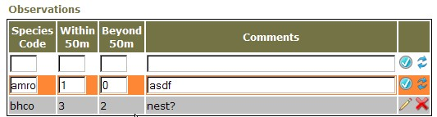
AMRO
BHCO
Notes:
The line undergoing editing is highlighted, and we enter the correct information.

Slide 18
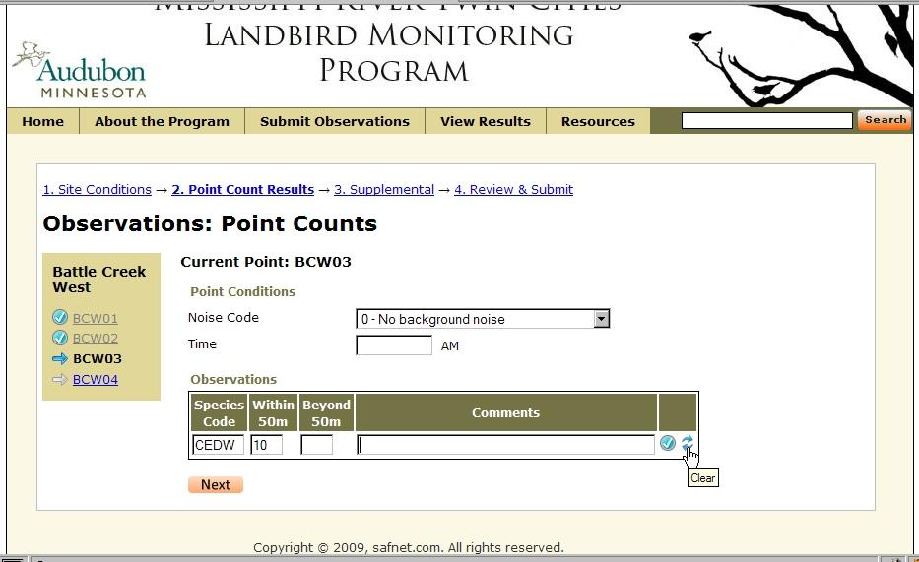
Notes:
As you advance through the data entry, you can track your progress through the points on the menu at left.

Slide 19
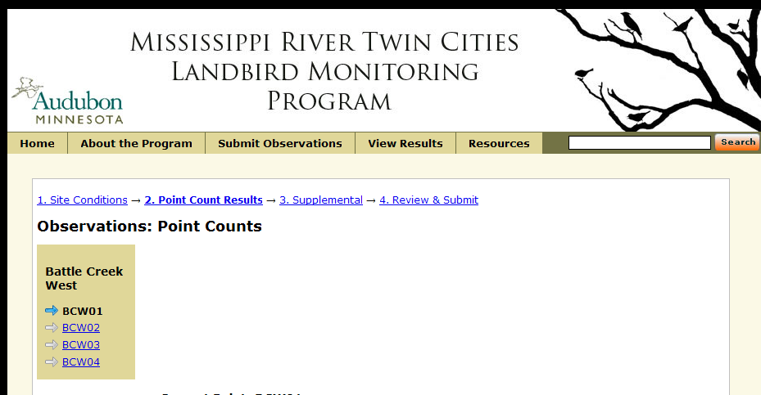
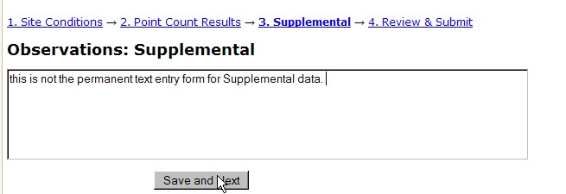
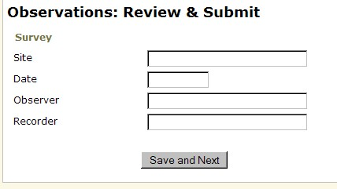
COHA being mobbed by 3 BLJA between BCW03 and BCW04
Notes:
Once you have completed entering the point count data, you can advance to the next step and add any supplemental observations you may have.
The next step, Review, will show all data entered and highlight any unlikely or unusual entries for further review. Perhaps you really did see a flock of 12 American Crows, or perhaps you meant to enter 1 bird within 50m and 2 beyond 50m. At this point, you can either make additional changes or Submit the data.

Slide 20
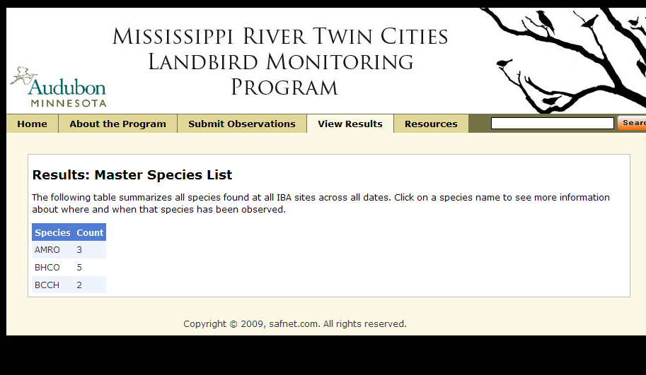
Notes:
The View Results tab will allow users of the site to explore the data based on species, site, and date.

Slide 21
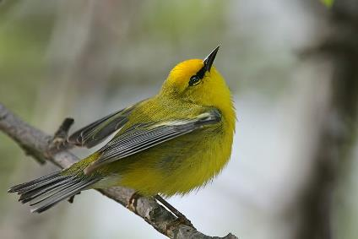
Immediate Goals
Use the Twin Cities IBA as a test case for linking local citizen science IBA monitoring to regional, national, and continental scales
Infrastructure to sustain and expand program
Image by Wolfgang Wander

Slide 22
Long-term Goals
Export this product to other interested IBAs
  Incorporate other data collection methods (removal sampling, transects, area search)
  Tools to enable Program Coordinators to set up own projects
Broaden scope beyond monitoring to IBA assessment
Notes:
Program coordinators for other IBAs will be able to go through site to set up sub-sites specific to their projects
-Upload Protocols and maps
-Set up data entry forms based on their protocols and datasheets
-Lat/long coordinates for points

Slide 23
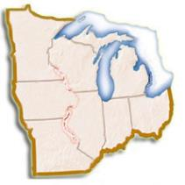
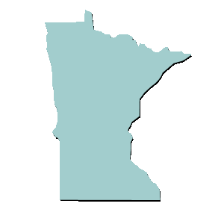
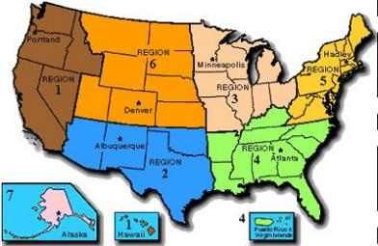
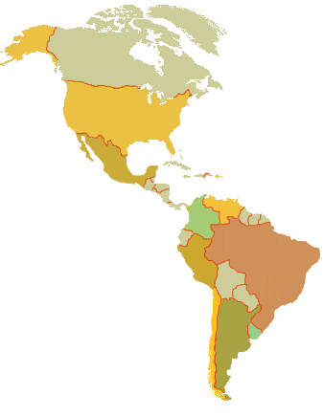
Local data
Regional monitoring data
Western hemisphere—breeding, migration, winter
Larger context for local data
U.S./North America
Notes:
Flow chart explaining context of IBA web-database to larger context of coordinated bird monitoring.

Slide 24



Acknowledgements
Funding for this project is supported by a U.S. Fish and Wildlife Service Grant for Migratory Bird Conservation in the Upper Midwest.

Slide 25
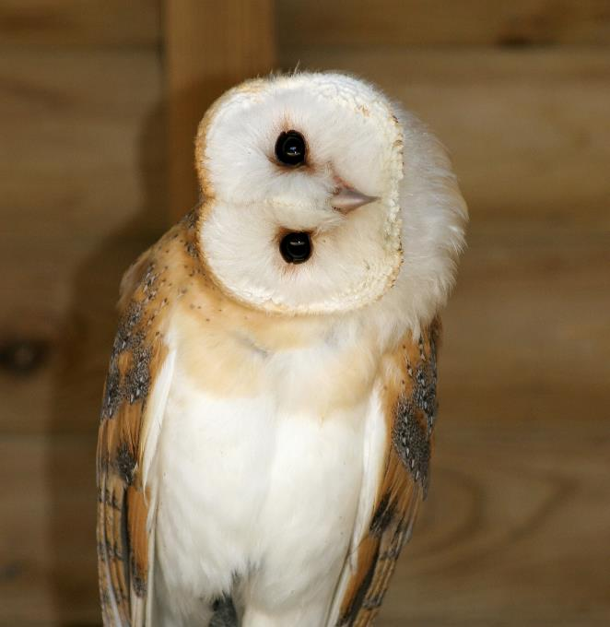
Questions?

